Slide 1

Community Detection on Social Networks using Social Facets.
Diksheet Agarwal(1912059)
Aditya Agarwal(1912104)
Mehul Dewangan(1912154)
Under the guidance of
Dr. Anupam Biswas
Assistant Professor
In Partial Fulfillment of the Fourth year UG Project Work
Department of Computer Science and Engineering
NIT Silchar, Assam

Slide 2
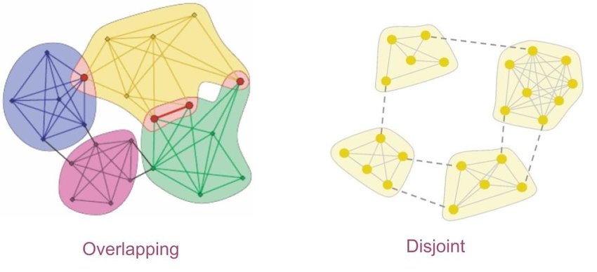
Networks in Social Network
Disjoint Community
Overlapping Community
Fig: Disjoint Community
Fig: Overlapping Community

Slide 3

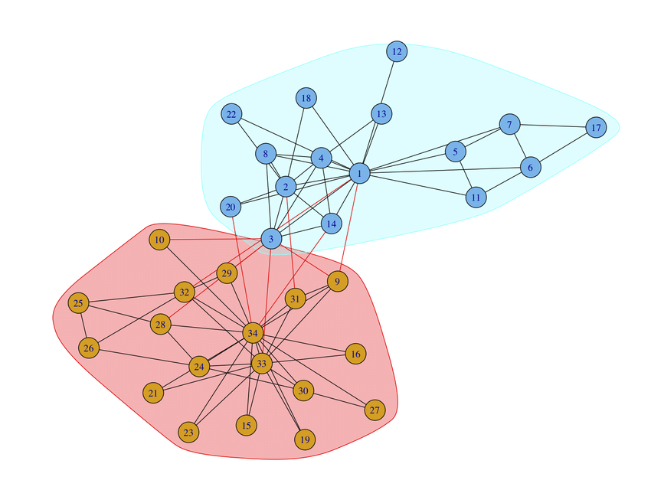
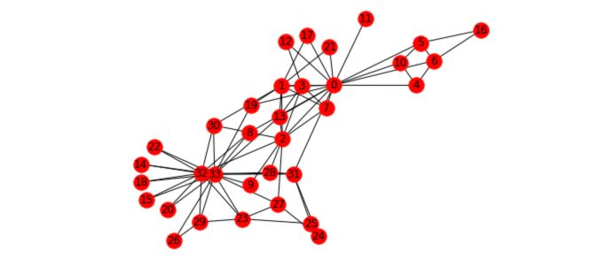
What is Community Detection?
Community: group of nodes which have high edge density intra groups and low edge density inter groups in any network.
Community Detection: in social network is used to analyse the structure of existing communities and identify important nodes inside communities.
Fig: Karate Club Network
Fig: Communities in Karate Club Network

Slide 4
Need for Community Detection / Problem Relevance
Rapid Growth of social Media.
Proper facilitation of services being rendered to the members of a community.
By identifying the friend groups, the people interrelationships can be analyzed.
More and better vigilance of malicious activities carried out on social media platforms can be done.

Slide 5
Literature Survey
Sl.no | Year | Name | Method/Algorithm | Remarks
1 | 2014 | Community detection in dynamic social networks: A game-theoretic approach[1] | Dynamic Game Theory method (D-GT) Treats the nodes of the network as rational agents | Precisely detection evolving and fine grained communities Good modularity index.
2 | 2017 | COSINE: Community-Preserving Social Network Embedding from Information Diffusion Cascades[2] | Probabilistic generative model Uses recurrent and time-stamped information diffusion cascades | Based on Euclidian distance

Slide 6
Sl.no | Year | Name | Method/ Algorithm | Remarks
3 | 2022 | A Fast Local Balanced Label Diffusion Algorithm for Community Detection in Social Networks[3] | Algorithm based on LBLD is proposed Communities are formed from both core and border nodes | Effective on small and large networks Triadic closure property
4 | 2022 | A cascade information diffusion based label propagation algorithm for community detection in dynamic social networks[4] | Cascade information diffusion model CIDLPA has been proposed | Detect overlapping communities network. Improved label propagation approach and accuracy
5 | 2018 | A fast community detection algorithm using a local and multi-level label diffusion method in social networks[5] | Algorithm based on FSLD is deployed Influence on node neighbours has been considered | Efficient time complexity Conflict resolution Discovers community accurately in large scale network

Slide 7
Sl.no | Year | Name | Method/ Algorithm | Remarks
6 | 2010 | A Hierarchical Diffusion Algorithm for Community Detection in Social Networks[6] | Adopts a hierarchical framework and discloses the community structures at different scales | Can distinguish between pseudo-community and meaningful ones
7 | 2022 | Information diffusion-aware likelihood maximization optimization for community detection[7] | Likelihood maximization model by utilizing the diffusion information and propose two different optimization algorithms to obtain community division of the network | This method does not require the network topology information as prior knowledge
8 | 2018 | Community Detection Using Diffusion Information[8] | Utilize the Conditional Random Fields to discover the community structures Community diffusion, do not require any prior knowledge about the network structure | This method is able to identify the hidden communities

Slide 8
Motivation
Community Detection is part of a much wider domain called Social Network Analysis. Through this, researchers are able to find the core nodes which have greater influence in the graphs and now the information is passed on, and it gives us a real sense of how communities are formed in real life.
Problem Statement
”Community detection on social networks using social facets.”.
Community detection is a crucial task in various fields, including social sciences, marketing, and cybersecurity.There is a need to explore new approaches that leverage social facets to improve the detection of communities.

Slide 9
A Fast Community Detection Algorithm Using a Local and Multi-Level Label Diffusion Method in Social Networks[5]
Uses fast and simple label diffusion method (FSLD)
Presents a new method using the method of label diffusion from marginal nodes by considering local criteria and similarities to discover communities with low time complexity.
Considering the importance of nodes and the influence of each node neighbors has increase the accuracy of finding communities.
Time Complexity O(nk); n is the number of nodes, k is the number of degree average

Slide 10
A Fast Local Balanced Label Diffusion Algorithm for Community Detection in Social Networks[4]
In this paper, a fast community detection algorithm based on local balanced label diffusion (LBLD) is proposed.
A new rough core detection method is proposed to uncover initial local communities to improve the stability and accuracy of the algorithm.
A new and fast merge method is adopted to obtain dense communities as far as possible.
Time Complexity: O(nk),n is the number of nodes, k is the number of degree average

Slide 11
Disjoint Community detection using Cascades
Disjoint Community detection using Cascades (DCC) algorithm uses 3 major concepts in social network analysis, which are:
Tie-strength
Cascades
Preferential Membership
Based on these concepts and cascade merging, the final communities are being derived.

Slide 12
LPANNI: Overlapping Community Detection Using Label Propagation in Large-Scale Complex Networks [10]
LPANNI detects overlapping communities by propagation sequence based on node importance and label update strategy based on neighbor node influence.
It consists of two phases. In the first phase, it computes the NI of all nodes and sorts the nodes in ascending order according to NI. In the second phase, it propagates labels by considering both the sequence of NI and NNI until the algorithm converges, then the overlapping community structure is detected.
It effectively avoid the randomness and thus improve the stability of LPA algorithms.

Slide 13


APAL: Adjacency Propagation Algorithm for overlapping community detection in biological networks [9]
APAL defines a community C as a subgraph of the given graph , in which the intraconnectivity of the community is above a given threshold value.
Intraconnectivity : , k is the sum of internal degrees within the community.
Threshold value is the only parameter the algorithm requires.
The running time for APAL is found as where m is the number of edges, n is the number of nodes.

Slide 14
Community Detection using Edge Reduction and Common Neighbor Selection (ERCNS)
ERCNS uses the concept of edge betweenness for detecting the communities
Edge betweenness measures the number of shortest paths that pass through a given edge in the network
Check the percentage of neighbors that lie in the current community.
When it’s greater than the threshold, the node is included in the community.

Slide 15
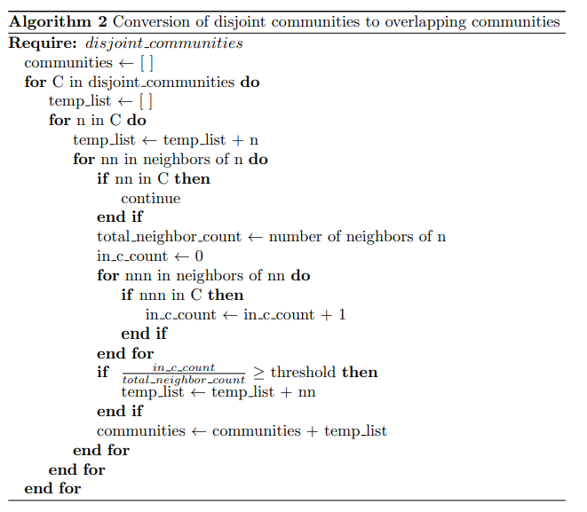
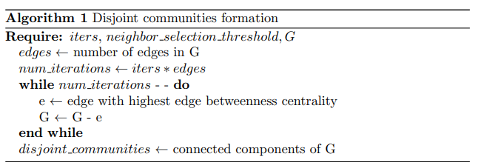
Algorithm 1: Disjoint Communities Formation
Algorithm 2: Conversion to overlapping communities

Slide 16
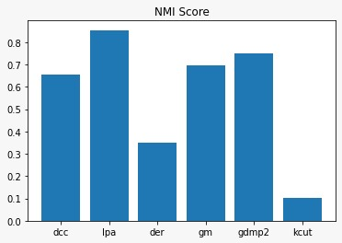
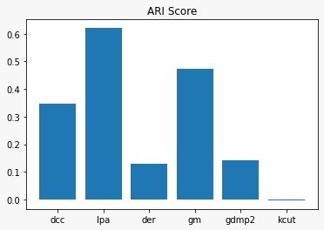
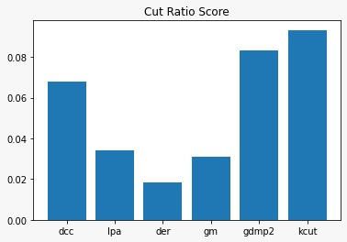
Results of DCC algorithm (Karate Club Dataset)
Fig: NMI Score
Fig: ARI Score
Fig: Cut Ratio

Slide 17
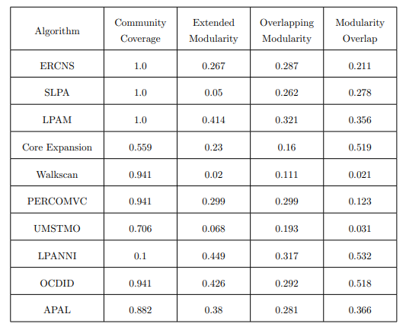
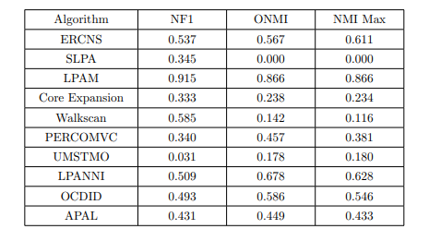
Results of Overlapping Algorithms
Table: Accuracy Matrices on Karate Club Dataset
Table: QualityMatrices on Karate Club Dataset

Slide 18
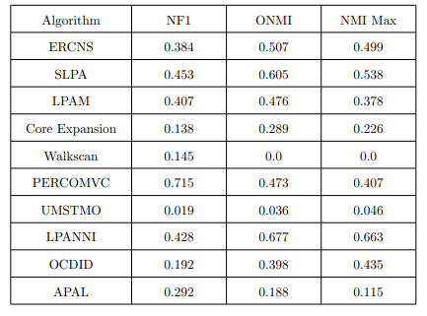
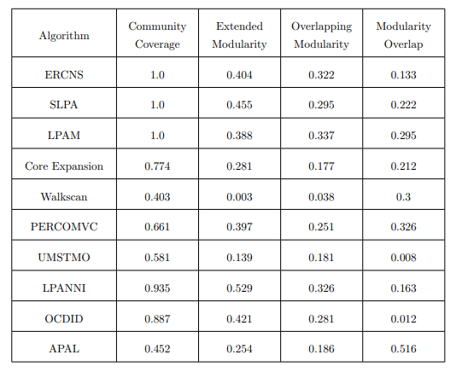
Results of Overlapping Algorithms
Table: Accuracy Matrices on DolphinDataset
Table: Quality Matrices on Dolphin Dataset

Slide 19
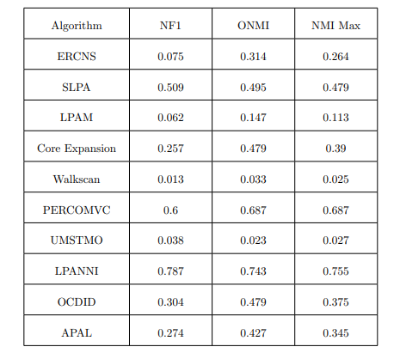
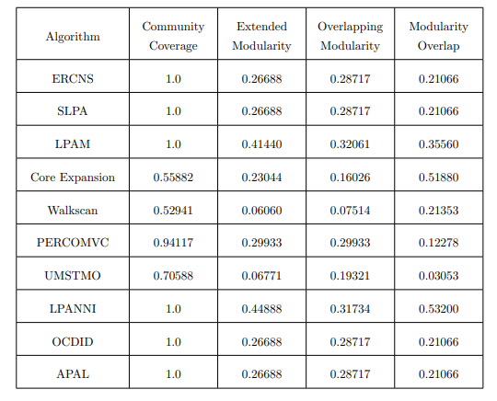
Results of Overlapping Algorithms
Table: Accuracy Matrices on Football Dataset
Table: Quality Matrices on Football Dataset

Slide 20
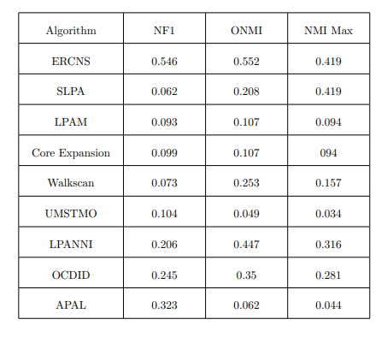
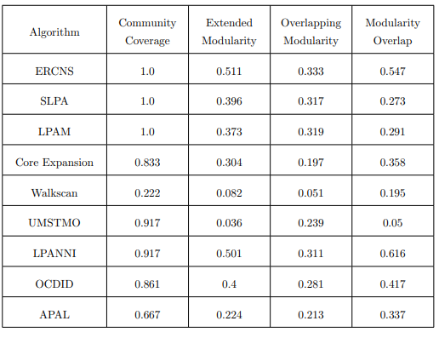
Results of Overlapping Algorithms
Table: Accuracy Matrices on Sawmill Dataset
Table: Quality Matrices on Sawmill Dataset

Slide 21
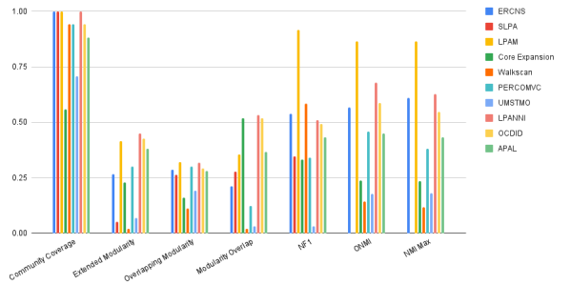
Results of Overlapping Algorithms (On Karate Club)

Slide 22
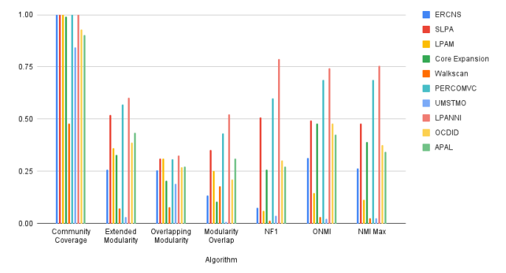
Results of Overlapping Algorithms (On Football)

Slide 23
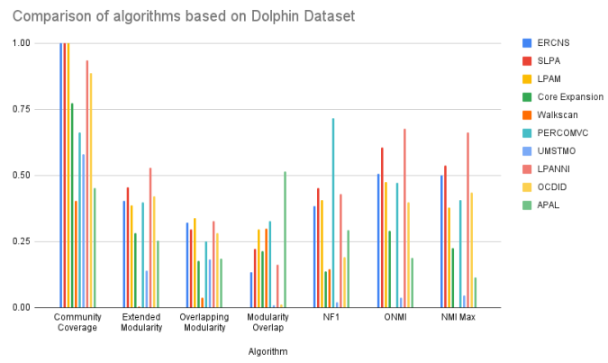
Results of Overlapping Algorithms (On Dolphin)

Slide 24

Complexity Analysis of ERCNS
e : Number of edges
n : Number of nodes I : The number of iterations (parameter) M : Average degree of nodes

Slide 25
Progress and Roadmap
Understanding Community Detection and its core concepts
Implementation of LBLD and DCC in python
Implementation of LPANNI algorithm in python
Implementation of ERCNS
Implementation of FSLD in python
Implementation of APAL algorithm
Implementation of 3rd paper
Development of a novel algorithm for community detection

Slide 26
References
[1] H. Alvari, A. Hajibagheri, and G. Sukthankar, “Community detection in dynamic social networks: A game-theoretic approach,” in Proc. IEEE/ACM Int. Conf. Adv. Social Netw. Anal. Mining (ASONAM ), Beijing, China, pp. 101–10,Aug. 2014.
[2] Y. Zhang, T. Lyu, and Y. Zhang, “Cosine: Community-preserving social network embedding from information diffusion cascades,” in Proc. AAAI Conf. Artif. Intell., vol. 32, no. 1, New Orleans, LA, USA, pp. 2620–2627,Feb. 2017.
[3] H. Roghani, A. Bouyer,”A Fast Local Balanced Label Diffusion Algorithm for Community Detection in Social Networks”, IEEE Transactions on Knowledge and Data Engineering, January 2022.
[4] M. Sattari and K. Zamanifar, “A cascade information diffusion based label propagation algorithm for community detection in dynamic social networks,” J. Comput. Sci., vol. 25, pp. 122–133, Mar. 2018.
[5] A. Bouyer, K. Azad and A. Rouhi,”A fast community detection algorithm using a local and multi-level label diffusion method in social networks”, International Journal of General Systems, vol. 51, no. 4, pp. 352–385, 2022.
[6] K. Shen, L. Song, X. Yang, and W. Zhang, “A hierarchical diffusion algorithm for community detection in social networks,” in Proc. Int. Conf. Cyber-Enabled Distrib. Comput. Knowl. Discovery, Huangshan, China, pp. 276–28, Oct. 2010.
[7] Z. Zhang, J. Wan, M. Zhou, K. Lu, G. Chen, H. Liao,” Information diffusion-aware likelihood maximization optimization for community detection”, Information Sciences, vol. 602, pp. 86-105, 2022.
[8] M. Ramezani, A. Khodadadi, and H. R. Rabiee, “Community detection using diffusion information,” ACM Trans. Knowl. Discovery from Data, vol. 12, no. 2, pp. 1–22, Mar. 2018.
[9] Osman Doluca, Kaya Oğuz, “APAL: Adjacency Propagation Algorithm for overlapping community detection in biological networks”, Information Sciences, vol 579, pp. 574-590, 2021

Slide 27
References
References
[10] M. Lu, Z. Zhang, Z. Qu and Y. Kang, "LPANNI: Overlapping community detection using label propagation in large-scale complex networks", IEEE Trans. Knowl. Data Eng., vol. 31, no. 9, pp. 1736-1749, Sep. 2019.
[11] A. Lancichinetti, S. Fortunato, and J. Kert ́esz, “Detecting the overlapping and hierarchical community structure in complex networks,”New journal of physics, vol. 11, no. 3,p. 033015, 2009.
[12] M. Jackson and Y. Zenou, Economic analyses of social networks volume I: Theory. Cheltenham, UK: Edward Elgar Publishing, 2013
[13] J. Xie, B. K. Szymanski, and X. Liu, “Slpa: Uncovering overlapping communities in social networks via a speaker-listener interaction dynamic process,” in 2011 ieee 11th international conference on data mining workshops, pp. 344–349, IEEE, 2011.
[14] K. Asmi, D. Lotfi, and M. El Marraki, “Overlapping community detection based on the union of all maximum spanning trees,”Library Hi Tech, vol. 38, no. 2, pp. 276–292, 2020.
[15] Z. Sun, B. Wang, J. Sheng, Z. Yu, and J. Shao, “Overlapping community detection based on information dynamics,” IEEE Access, vol. 6, pp. 70919–70934, 2018.
[16] A. Ponomarenko, L. Pitsoulis, and M. Shamshetdinov, “Overlapping community detection in networks based on link partitioning and partitioning around medoids,” Plos one vol. 16, no. 8, p. e0255717, 2021.
[17] A. Hollocou, T. Bonald, and M. Lelarge, “Improving pagerank for local community detection,”arXiv preprint arXiv:1610.08722, 2016.
[18] A. Choumane, A. Awada, and A. Harkous, “Core expansion: a new community detection algorithm based on neighborhood overlap,”Social Network Analysis and Mining, vol. 10, pp. 1–11, 2020.
[19] N. Kasoro, S. Kasereka, E. Mayogha, H. T. Vinh, and J. Kinganga, “Percomcv: A hybrid approach of community detection in social networks,” Procedia Computer Science,vol. 151, pp. 45–52, 2019

Slide 28
References
References

Slide 29
Thank You

